Slide 1
Data Analytics Interim Project Proposal Group 4

Slide 2
Group 4
Sylwia Kisielewska
Ola Abdelrazek
Oluwaseyi Badero
Vina Suzette Matibag

Slide 3
Table of contents
01
02
03
04
Introduction
Analysis
Overview of the group’s proposal
Describes the analysis and methods used for each question
Results
Conclusions
Showcase results in figures and graphs
Recommendations for further investigations

Slide 4
01
Introduction

Slide 5
Overview
Investigated the relationship between multiple variables in the AdventureWorks2019 database to determine any issues, make meaningful insights and identify potential opportunities for the company.
SQL queries to refine and efficiently extract data in a CSV format and importing it to Python using Pandas.
Python calculations and visualisation highlighted a number of trends, patterns and relationships in AdventureWorks2019 in regard to its Stores, Sales, Revenue and Employees.
Presented the results using charts and graphs to get a better clarity of the relationships (if there is any) and pointed at key results, highlighted any outliers, and identify areas for improvement.

Slide 6
Methods of Analysis
SQL Query to refine and filter data
Import in Python using Pandas
Step 1
Step 3
Step 2
Step 4
Extract SQL Query results as CSV
Transform and visualize results in Python

Slide 7
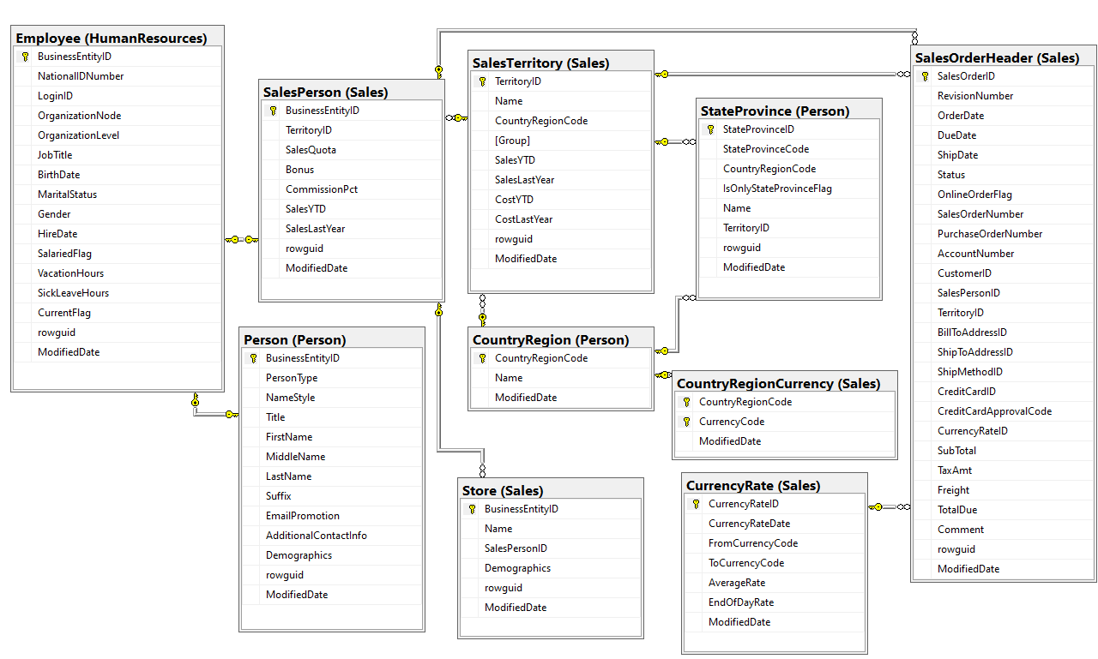
Concepts in Schema

Slide 8
Questions for Analysis
What are the regional sales in the best performing country?
What is the relationship between annual leave taken and bonus?
What is the relationship between Country and Revenue?
What is the relationship between sick leave and Job Title (PersonType)?
What is the relationship between store trading duration and revenue?
What is the relationship between the size of the stores, number of employees and revenue?

Slide 9
02 & 03
Analysis & Results

Slide 10
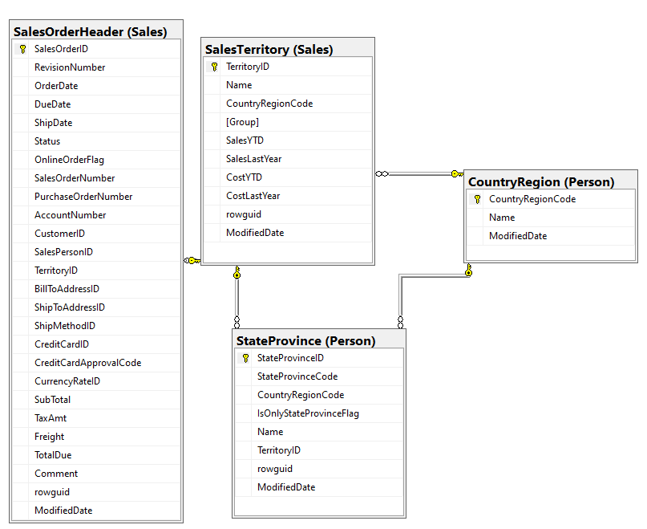
What are the regional sales in the best performing country?

Slide 11
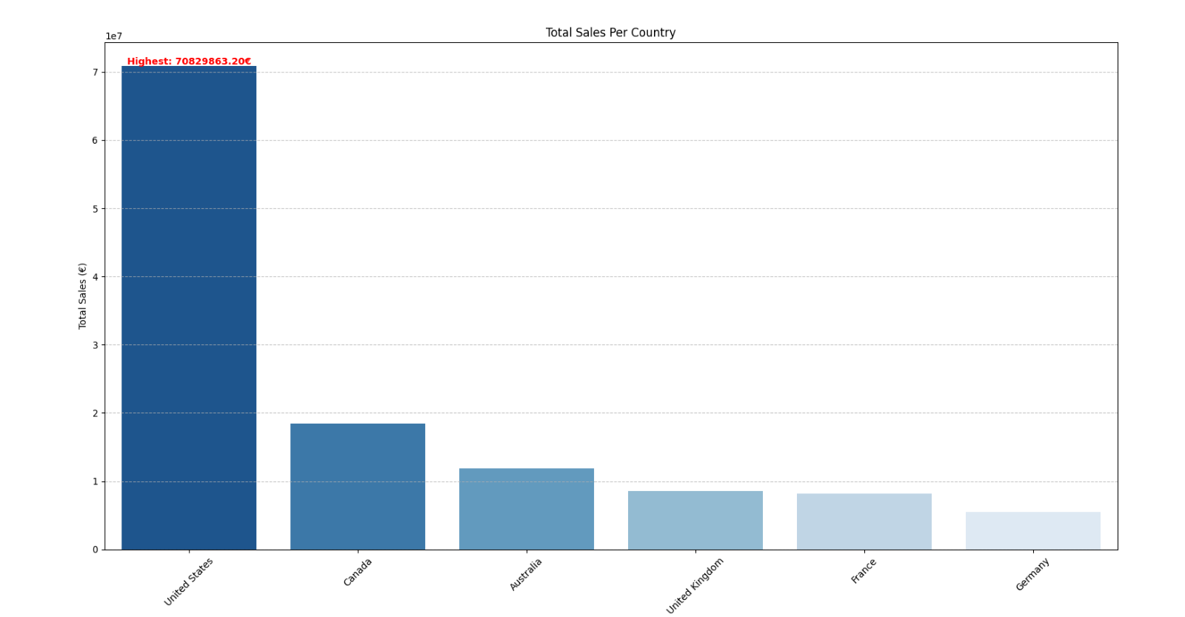
Country Sales Analysis

Slide 12
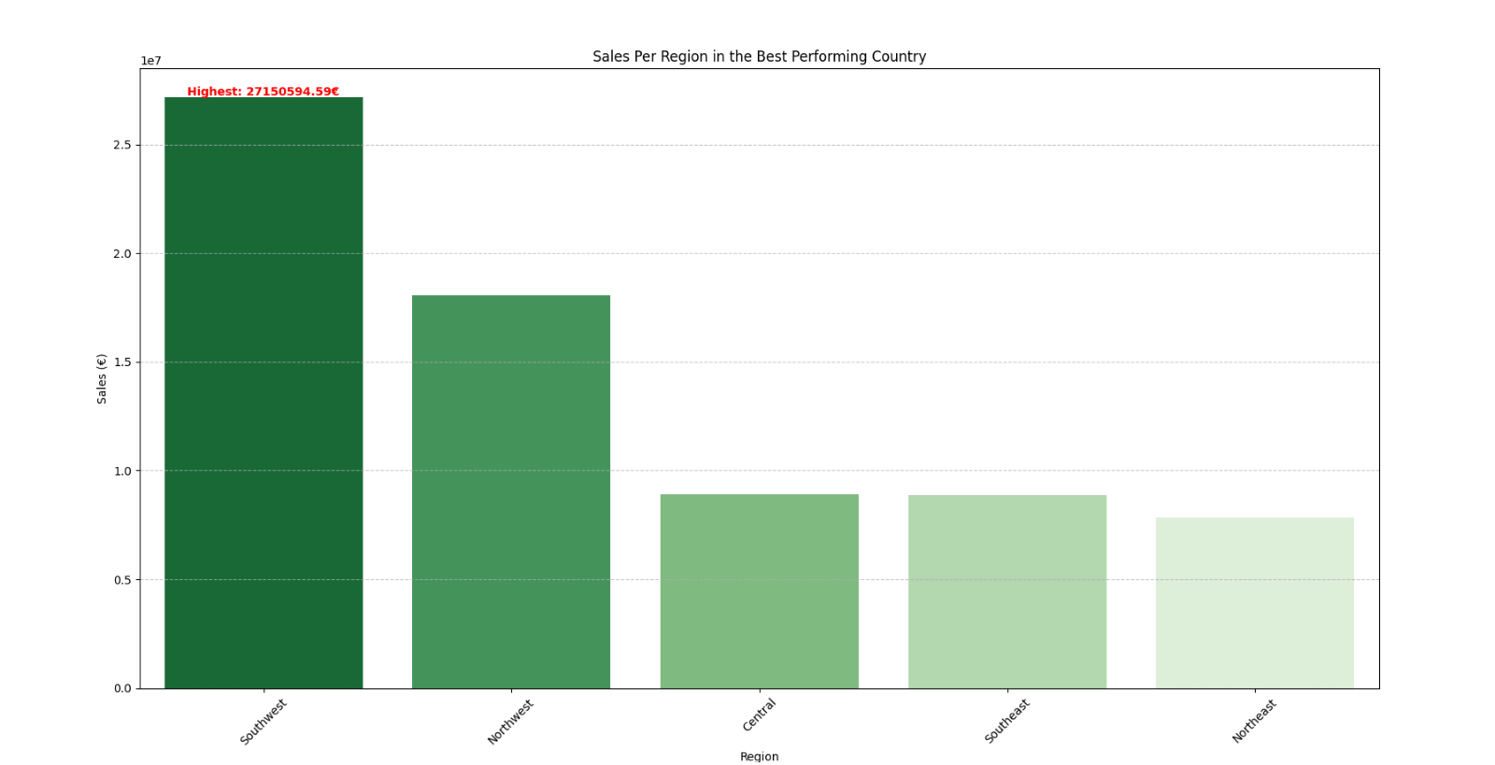
Regional Sales in the Best Country (USA)

Slide 13
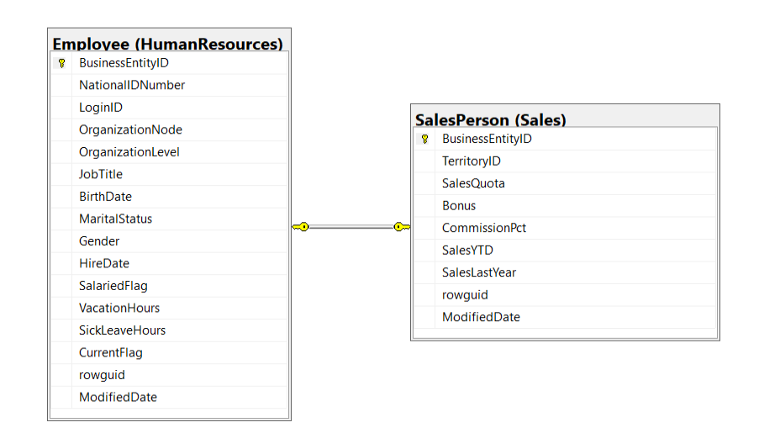
2. What is the relationship between annual leave taken and bonus?

Slide 14
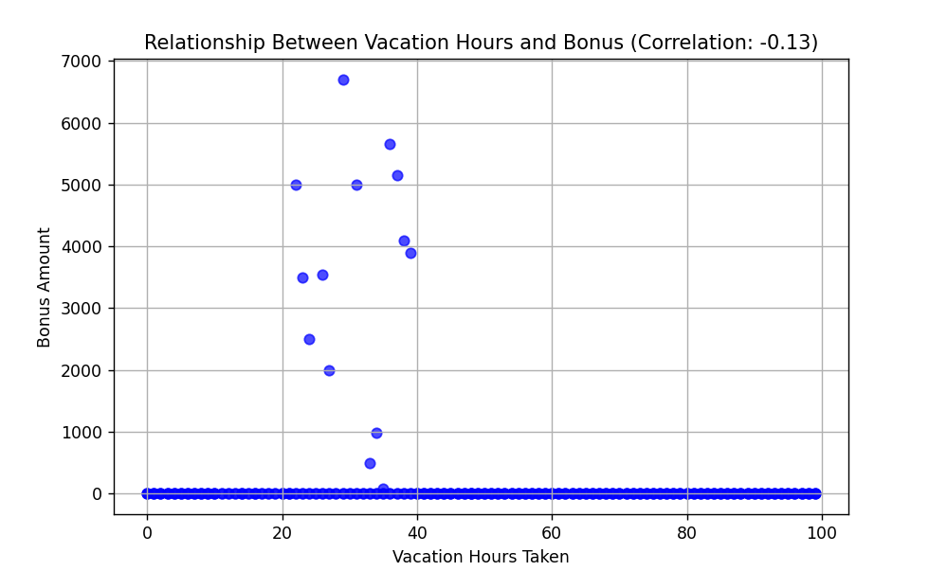
Correlation between Vacation Hours Taken and Bonus
Suggest that employees who take more vacation hours tend to have slightly lower bonuses.
Slight connection for more frequent bonuses awarded when annual leave hours were in range from 20 to 40 hours. Another possible factors could be job performance, role and type, gender, economic factors, bonus timing.

Slide 15
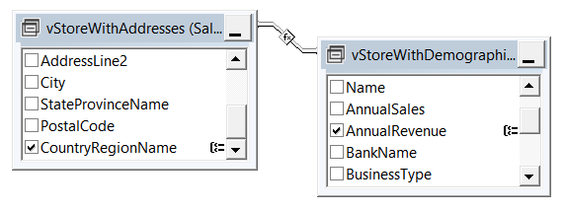
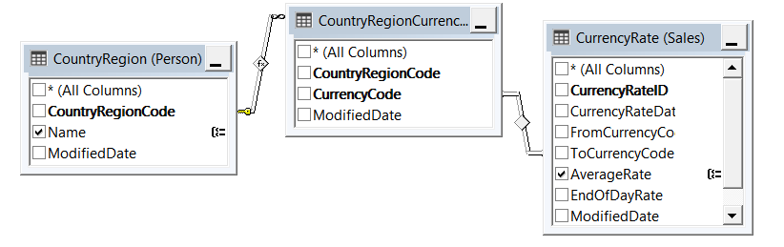
3. What is the relationship between Country and Revenue?

Slide 16
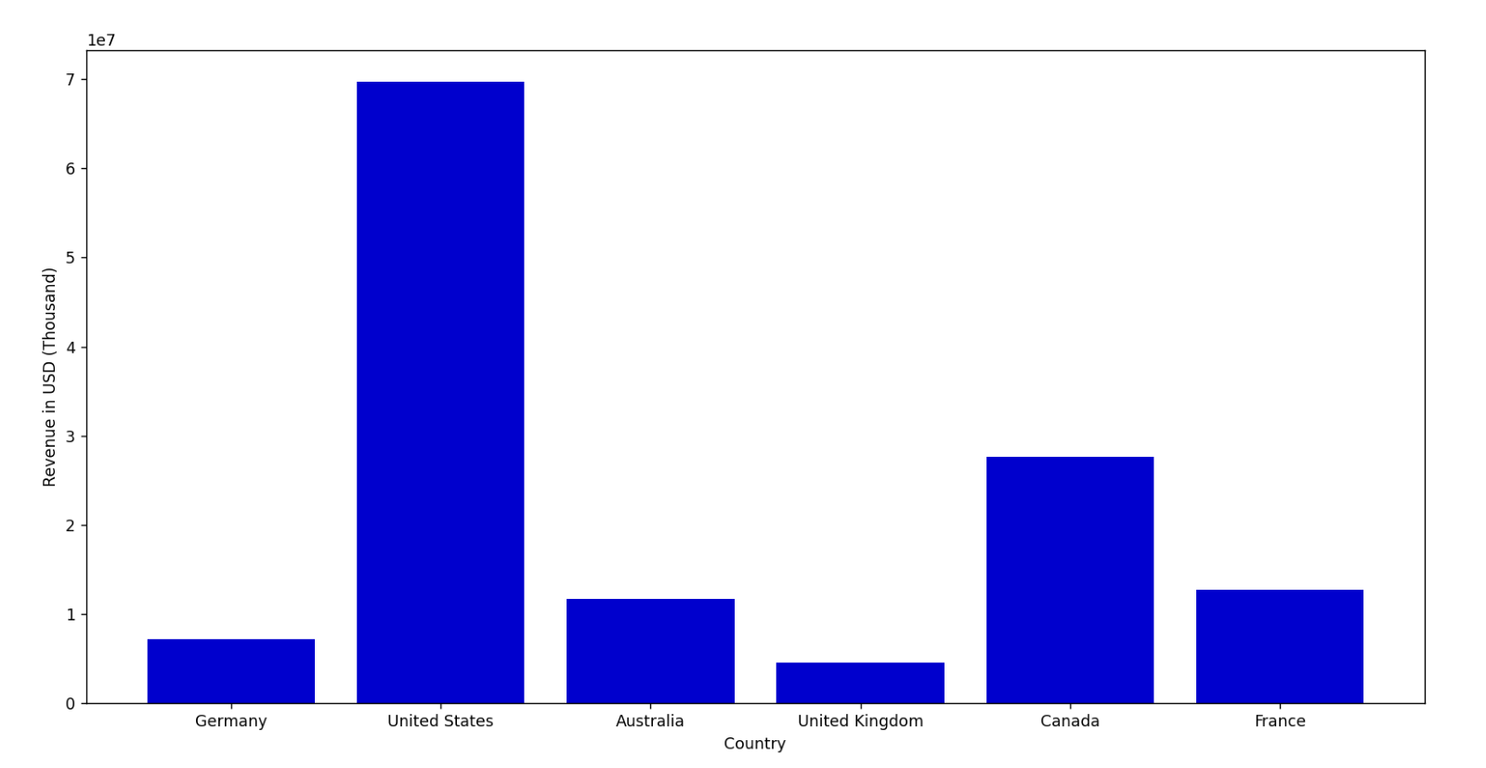
Country and Revenue Analysis

Slide 17
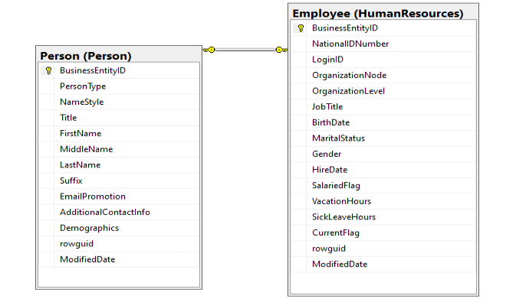
4. What is the relationship between sick leave and Job Title (PersonType)?

Slide 18
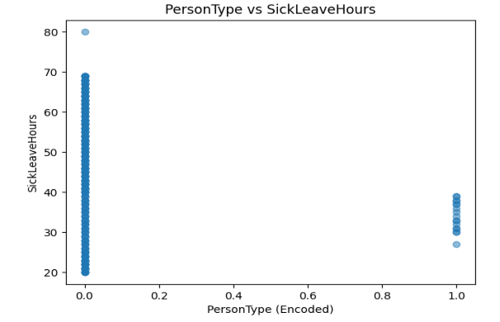
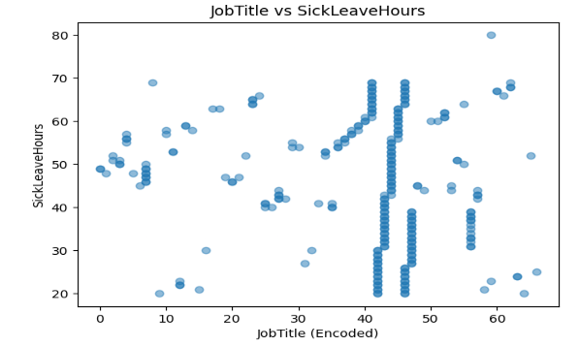
Person Type/Job Title and Sick Leave
corr=-0.19
corr=-0.12

Slide 19
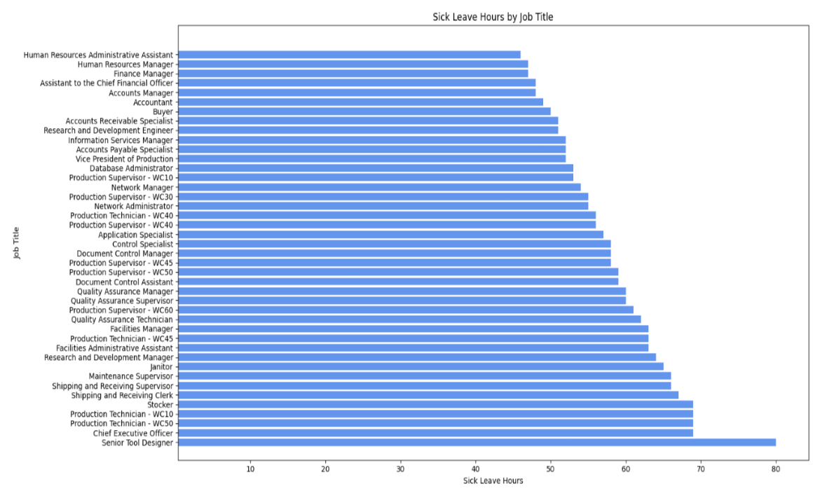
Highest Sick Leave Entries Analysis
All Job Titles have entries of above average sick leave hours (45.3 hours)
Highest Sick Leave Entry is from a Senior Tool Designer

Slide 20
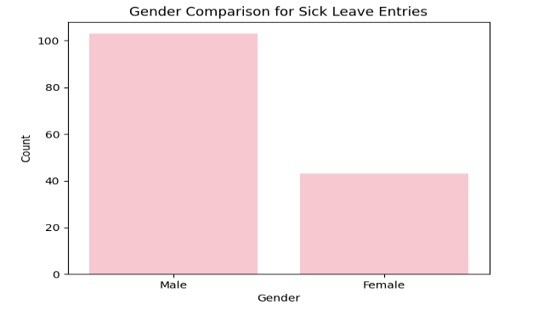
Extra Analysis: Gender Comparison
Amongst 146 entries for above average sick leave, there were 103 males and 43 females.

Slide 21
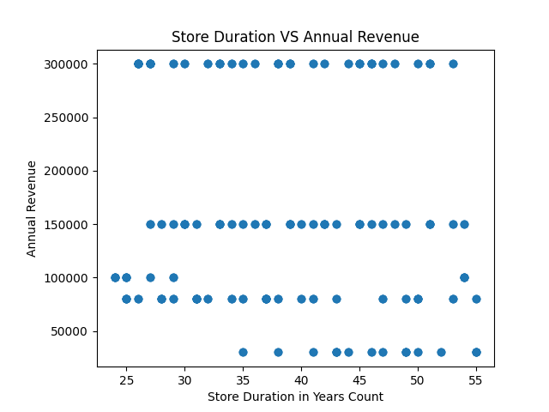
5. What is the relationship between store trading duration and revenue?
Negative and weak correlation (-0.133), indicating that older stores tend to have lower revenues but it is not as significant.

Slide 22
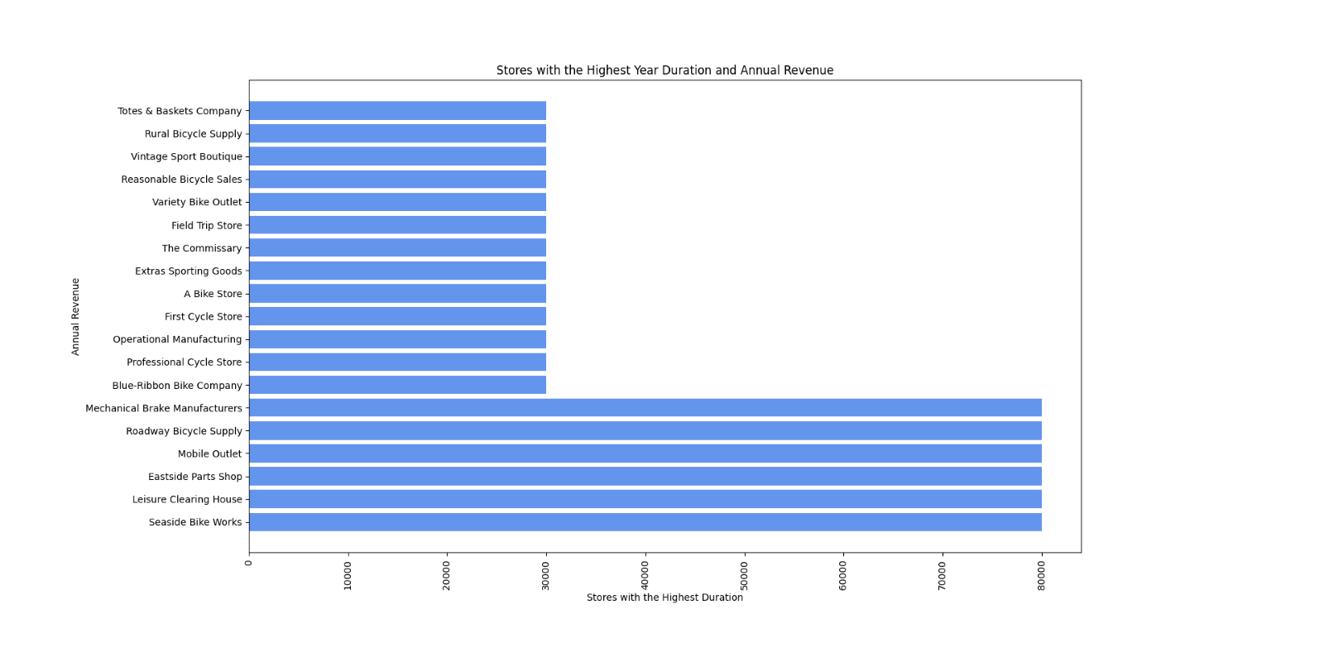
Stores with the Highest Store Duration and their Annual Revenue
All these stores opened in 1970 with 55 years of trading duration.
Some of the stores with longer durations do not necessarily show high revenue.

Slide 23
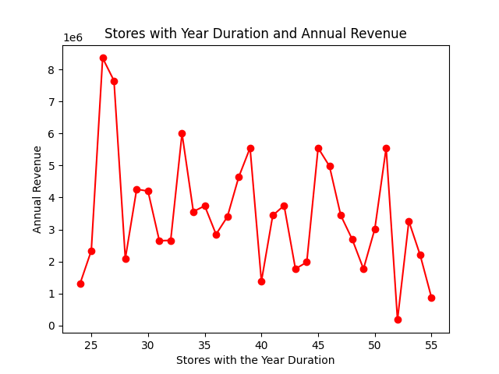
Total Stores Year Duration and Annual Revenue
Stores with durations of 25-26 years appear to generate the highest revenues
50 years and above generate the lowest revenues
Increase in revenue every 5-7 years, suggesting that stores might experience growth spurts

Slide 24
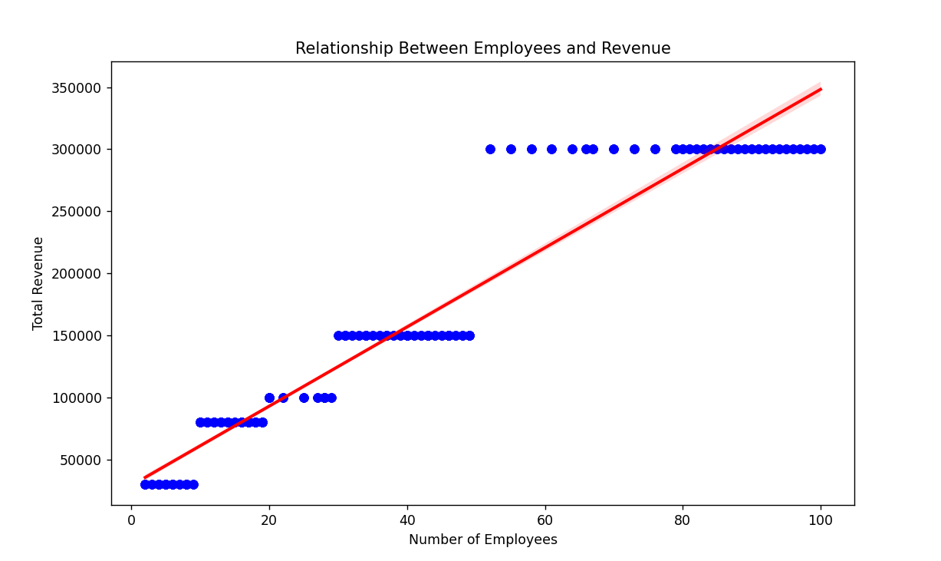
6. What is the relationship between the number of employees and revenue?
Correlation = (0.96): Strong
As business expand their workforce, their revenue tends to increase.

Slide 25
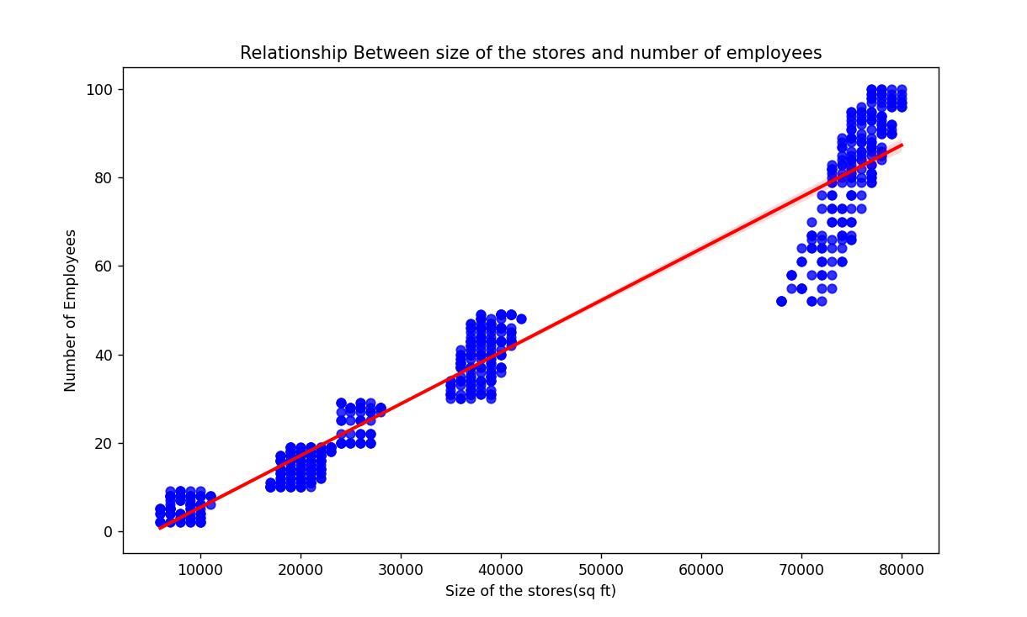
The relationship between the size of the stores and number of employees
Correlation = (0.97): Strong
Larger stores requires more staff.

Slide 26
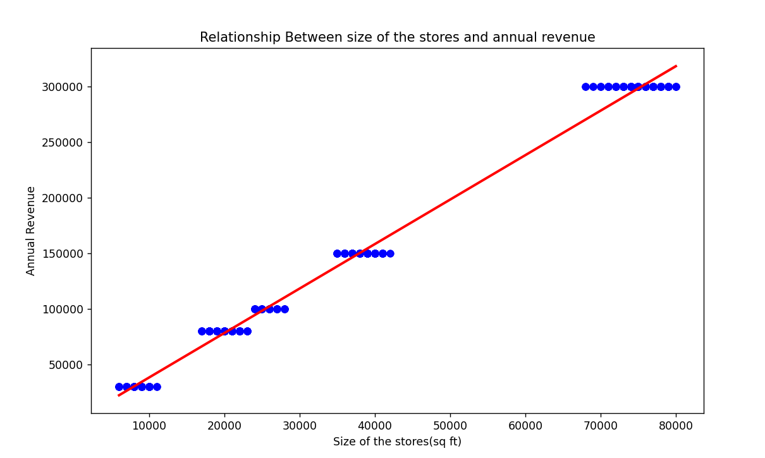
The relationship between the size of the stores and revenue
Correlation = (0.99):Strong
Store size is a factor influencing revenue

Slide 27
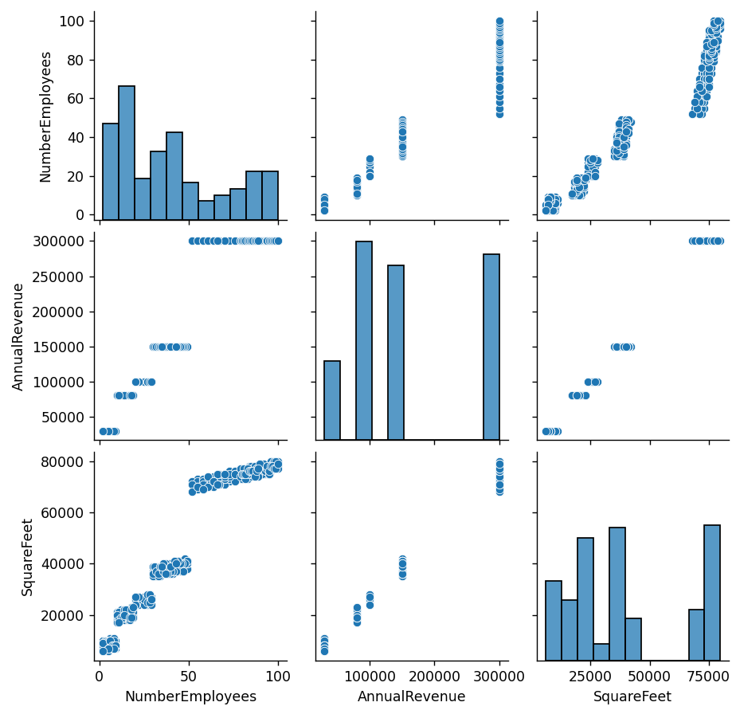
Comparison pair plot in Seaborn
These findings suggest that expanding store size and workforce can significantly contribute to higher revenue growth.

Slide 28
04
Conclusion

Slide 29
Conclusion
Our analysis of the database provided valuable insights into the relationships between various business variables.
We were able to uncover key trends, patterns, and potential areas for improvement.
The visualizations helped to clarify these relationships and highlight opportunities that could drive better decision-making and business growth.
The analysis can help optimize operations and boost performance within the company.

Slide 30
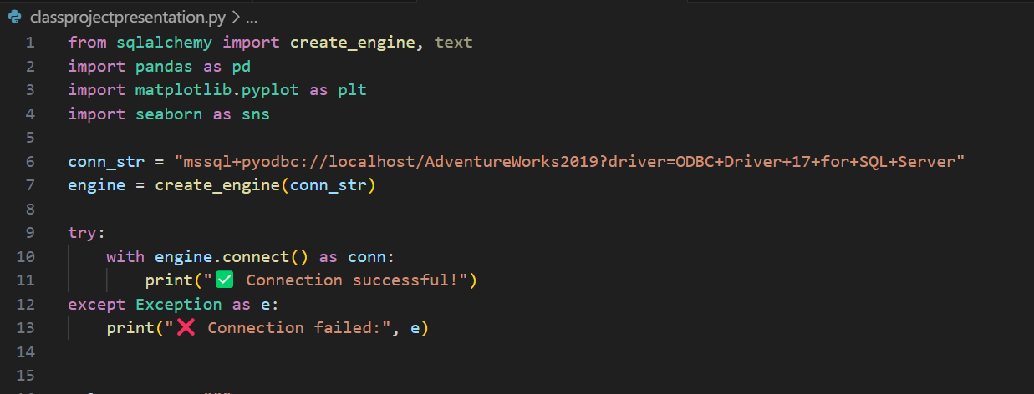
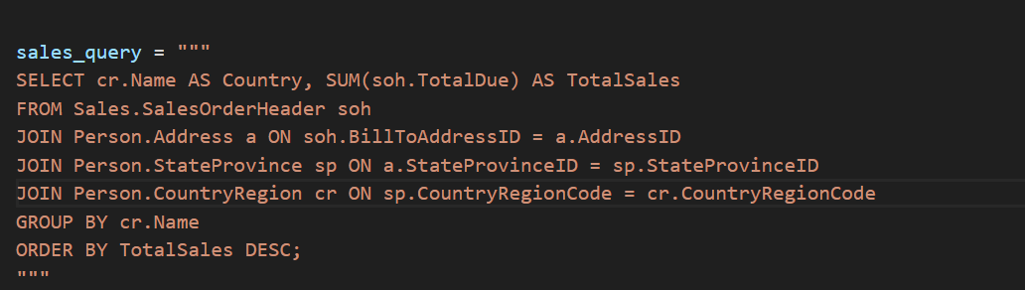
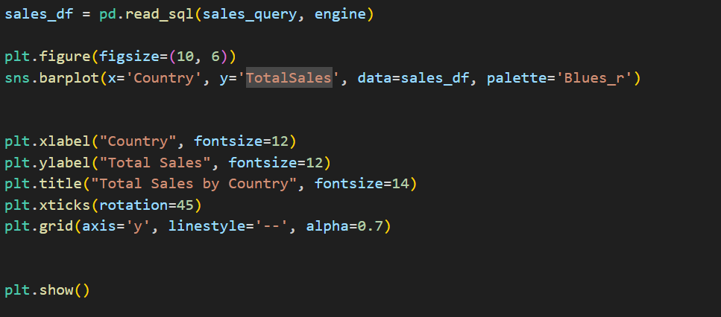
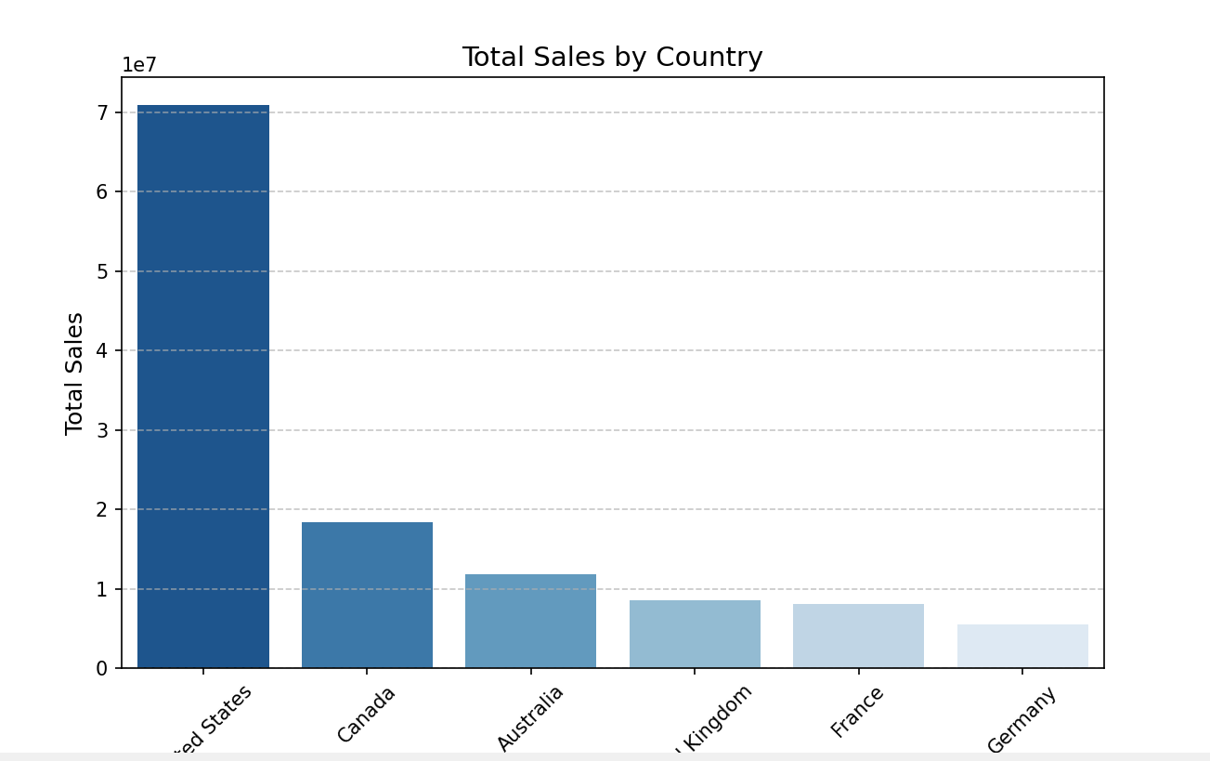
Extra Info: Alternative way to access sql sql SQL Query in Python

Slide 31
Thanks!
Do you have any questions?

